Slide 1
Industry Life Cycle & Value Chain
Industry life cycle
Industry structure
The environment of the industry
The competitive environment
Competitive strategy
Copyright © Houghton Mifflin Company
4-<number>

Slide 2
Industry Life Cycle
Growing
Established
Emerging
Decline
New Technology
Copyright © Houghton Mifflin Company
4-<number>

Slide 3
Industry Structure
Threat of new entrants
  Economies of scale
  Brand loyalty
Threat from substitute products
Threat from buyers’ bargaining power
Threat from suppliers’ bargaining power
Rivalry among existing firms
Threat of technology
Copyright © Houghton Mifflin Company
4-<number>

Slide 4

What Do You Want to Know?
Is the industry growing?
What are the trends?
Are there young, successful firms in
the industry?
Copyright © Houghton Mifflin Company
4-<number>

Slide 5

More Things to Know
What is the status of new technology?
How much is spent
on R&D?
Are there any threats?
What are the
gross margins?
Copyright © Houghton Mifflin Company
4-<number>

Slide 6
Industry Analysis–The Environment
Carrying capacity
Dynamism
Complexity
Copyright © Houghton Mifflin Company
4-<number>

Slide 7
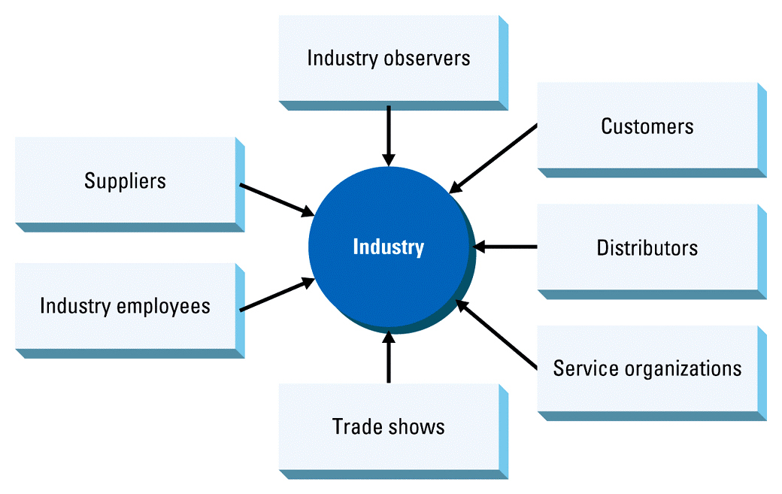
Sources of Field Data on the Industry
Copyright © Houghton Mifflin Company
4-<number>

Slide 8
Understand Competitive Strategies in the Industry
Cost superiority
Differentiation
  Product
  Service
  Distribution
Niche
Copyright © Houghton Mifflin Company
4-<number>

Slide 9
Identifying the Competition
Direct competitors
Indirect or substitute competitors
Emerging competitors
Copyright © Houghton Mifflin Company
4-<number>

Slide 10
Competitor Analysis
Identify competitors’ core competency
  Differentiates
  Provides competitive advantage
  Transferable to other business
Is often not the logical competency
Copyright © Houghton Mifflin Company
4-<number>

Slide 11
What You Have to Do
Determine what your competitor has to do to be successful in its own core business
Determine which of the competencies it has that are transferable to your business
Determine whether it has a strong competency in those particular areas relative to your own company
Copyright © Houghton Mifflin Company
4-<number>

Slide 12
Value Chain Analysis
Each activity in a business adds value
  If an activity does not add value, it should
  be discontinued
Control and protect the activities that add the greatest value
Good for comparing two companies
Copyright © Houghton Mifflin Company
4-<number>

Slide 13
Patent Citation Analysis
You can develop useful intelligence from looking at your competitor’s patents
A stream of patents assigned to a company can reveal a strategy
Copyright © Houghton Mifflin Company
4-<number>

Slide 14
Competitive Entry Strategies
Cost Superiority
  Difficult for a new venture
Differentiation
  Through product/process innovation or a unique marketing or distribution strategy
Niche Strategy
  Focus on a customer group or need that is not being served
Copyright © Houghton Mifflin Company
4-<number>

Slide 15
The Ideal Industry
Over Rs 100 Crore in sales
Growing at a rate greater than the GNP
After-tax profits of greater than 5 percent of sales within 3–5 years
Socially and environmentally responsible
Copyright © Houghton Mifflin Company
4-<number>

